Slide 1
STORED
PROCEDURES
Jose Annunziato

Slide 2
Introduction
Stored procedure encapsulate repetitive tasks
Can declare variable
Flow control and other typical programming language constructs
Generally stored procedures are encouraged
In practice they can be difficult to develop, debug, maintain, and port

Slide 3
Pros
Abstraction: hide low level table access behind a higher level API
Security: secure data access granting privileges to stored procedures, not to users or tables
Network performance: Can implement coarse API for reduced remote procedure calls, reduced network traffic, improved performance

Slide 4
Cons
Application logic spread over several stacks / technologies
Harder to maintain
Complicates migrating to a different vendor
Additional burden on database
Yet another language to learn

Slide 5
Triggers, Functions & Procedures
 | Functions | Procedures | Triggers
Changes Data | No | Yes | Yes
Returns Data | Always | Sometimes | Never
When Called | Part of Statement | Executed | Event Driven

Slide 6
FUNCTIONS
Dr. Jose Annunziato

Slide 7
Creating Functions
CREATE FUNCTION `function_name`
(optional, parameters)
Names are case insensitive and unique
No data schema manipulation statements in procedures, i.e., create, alter, drop
Choose delimiter other than ";", e.g., "//", "@@"
DELIMITER //

Slide 8
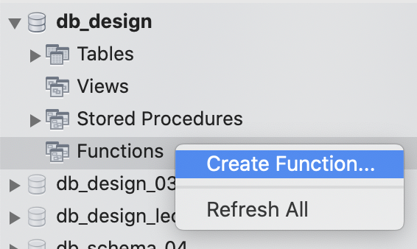
Creating Functions from Workbench
Right click Functions and select Create Function...
Edit default function
CREATE FUNCTION `new_function` ()
RETURNS INTEGER
BEGIN
RETURN 1;
END

Slide 9

Create Simple 2 + 2 Function
Create simple function
Click Apply
Review and Apply again
CREATE FUNCTION `add_2_2` ()
RETURNS INTEGER
BEGIN
RETURN 2 + 2;
END
USE `db_design`;
DROP function IF EXISTS `add_2_2`;
DELIMITER $$
USE `db_design`$$
CREATE FUNCTION `add_2_2` ()
RETURNS INTEGER
BEGIN
RETURN 2 + 2;
END$$
DELIMITER ;

Slide 10
Using a Function in a Select
You can use a function wherever a single value is accepted
The following evaluates to 4
SELECT add_2_2();
add_2_2()
4

Slide 11
Adding A and B
Functions can take arguments
CREATE FUNCTION `add_a_b` (a INT, b INT)
RETURNS INTEGER
BEGIN
RETURN a + b;
END
SELECT add_a_b(2, 3);
add_a_b()
5

Slide 12
Using Functions in SELECT
Consider table B with content:
You can use function add_a_b() declared earlier:
SELECT a, c, add_a_b(a, c) AS 'a + c'
FROM B;
Yielding the following result:
id | a | b | c
1 | 12 | qwe | 34.45
2 | 23 | wer | 45.56
3 | 34 | ert | 56.67
a | c | a + c
12 | 34.45 | 46
23 | 45.56 | 69
34 | 56.67 | 91

Slide 13
Hello World
Functions can return any data type, e.g., VARCHAR:
CREATE FUNCTION `hello_world` ()
RETURNS VARCHAR(20)
BEGIN
RETURN 'Hello World!';
END
SELECT hello_world();
hello_world()
Hello World

Slide 14
STORED
PROCEDURES
Dr. Jose Annunziato

Slide 15
Creating Functions
CREATE PROCEDURE `function_name`
(optional, parameters)
Names are case insensitive and unique
No data schema manipulation statements in procedures, i.e., create, alter, drop
Choose delimiter other than ";", e.g., "//", "@@"
DELIMITER //

Slide 16
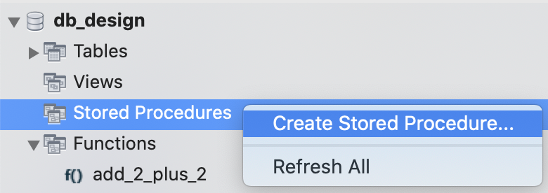
Creating Functions from Workbench
Right click Functions and select Create Function...
Edit default procedure
CREATE PROCEDURE `new_procedure` ()
BEGIN
END

Slide 17
Embed SQL Scripts in Procedures
Procedures can group SQL statements into reusable scripts
Let's retrieve all records in table 'p'
CREATE PROCEDURE
`get_all_ps` ()
BEGIN
SELECT * FROM p;
END
USE `db_design`;
DROP procedure IF EXISTS `get_all_ps`;
DELIMITER $$
USE `db_design`$$
CREATE PROCEDURE
`get_all_ps` ()
BEGIN
SELECT * FROM p;
END$$
DELIMITER ;

Slide 18
Invoke Procedures with CALL
Procedures are invoked with CALL
CALL get_all_ps();
SQL in procedure executes and result is printed to console
id | first | last
1 | Alice | Wonderland
2 | Bob | Hope
3 | Charlie | Brown
4 | Dan | Craig
5 | Edward | Scissorhands

Slide 19
Students Graduated After 2000
Retrieving students graduated after 2000
CREATE PROCEDURE graduates_after_2000
BEGIN
SELECT name, gradyear
FROM students
WHERE gradyear > 2000
END
Name | Gradyear
Joe | 2001
Alice | 2003

Slide 20
Procedure Parameters
CREATE PROCEDURE
`get_salary_ge` (s FLOAT)
BEGIN
SELECT * FROM p
WHERE salary >= s;
END
CALL get_salary_ge(3000);
id | first | last | salary
1 | Alice | Wonderland | 4321
2 | Bob | Hope | 5432
3 | Charlie | Brown | 1234
4 | Dan | Craig | 2345
5 | Edward | Scissorhands | 3456
id | first | last | salary
1 | Alice | Wonderland | 4321
2 | Bob | Hope | 5432
5 | Edward | Scissorhands | 3456

Slide 21
Calling Stored Procedures
MySQL uses CALL
CALL HelloWorld (param1, param2, ....)
CALL hello(10 , 'John Doe' , @parameter_var);
MS SQL instead uses EXEC or EXECUTE
EXEC HelloWorld
EXECUTE HelloWorld

Slide 22
Alter and Delete Stored Procedures
Use ALTER PROCEDURE to change the procedure or characteristics
Can drop procedure and start over
DROP PROCEDURE IF EXISTS p2;
Use IF EXISTS to prevent error if doesn't exist

Slide 23
Modifying Stored Procedures Manually
Use ALTER to modify a procedure
ALTER PROCEDURE my_procedure
BEGIN
SELECT 'Hello World !';
END
Or DROP the procedure and redefine it

Slide 24
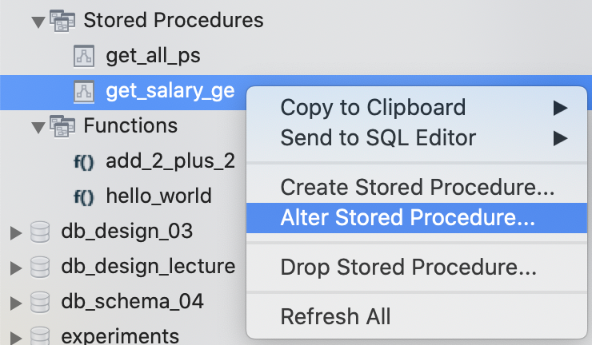
Alter Procedure from Workbench
Right click procedure, select Alter Stored Procedure…
Edit and Apply. Workbench will drop and recreate
DROP PROCEDURE IF EXISTS `get_salary_ge`;
CREATE PROCEDURE `get_salary_ge`(s FLOAT)
BEGIN
SELECT * FROM p WHERE salary > s;
END$$
DELIMITER ;

Slide 25
PARAMETERS
Dr. Jose Annunziato

Slide 26
Parameters
No parameters
CREATE PROCEDURE proc1 ()
INput parameters. Optional, default, original value unchanged
CREATE PROCEDURE proc1 ([IN] varname TYPE)
OUTput parameters. Initial value not accessible
CREATE PROCEDURE proc1 (OUT varname TYPE)
Both IN and OUT. Initial value accessible, can be changed
CREATE PROCEDURE proc1 (INOUT varname TYPE)

Slide 27
IN Behaves Like Pass by Value
CREATE PROCEDURE `in_parameter_example` (IN b INT)
BEGIN
SET b = b + 1;
SELECT b;
END
SET @a=123;
SELECT @a;
CALL in_parameter_example(@a);
SELECT @a;
IN variables can't change original variable. They can only read value and change locally
@a
123
b
124
@a
123

Slide 28
OUT Sets Value of Original Variable
CREATE PROCEDURE `out_parameter_example` (OUT b INT)
BEGIN
SET b = 321;
SELECT b;
END
SET @a=123;
SELECT @a;
CALL out_parameter_example(@a);
SELECT @a;
OUT variables don't have access to original value. They can update original variable
@a
123
b
321
@a
321

Slide 29
INOUT Behaves Like Pass by Reference
CREATE PROCEDURE `inout_example` (INOUT b INT)
BEGIN
SET b = b + 1;
SELECT b;
END
SET @a=123;
SELECT @a;
CALL inout_example(@a);
SELECT @a;
INOUT variables can access original value and update original variable
@a
123
b
124
@a
124

Slide 30
VARIABLES
Dr. Jose Annunziato

Slide 31
Return Values
CREATE FUNCTION my_proc
BEGIN
SELECT "Hello World !"
RETURN 123
END
DECLARE @return_value AS int
CALL @return_value = myProc
SELECT @return_value
my_proc
Hello World !
@return_value
123

Slide 32
Return Values
CREATE PROCEDURE my_proc
BEGIN
SELECT "Hello World !"
SELECT "Goodbye"
RETURN 123
END
DECLARE @return_value AS INT
CALL @return_value = my_proc()
SELECT @return_value
my_proc
Hello World !
my_proc
Goodbye
@return_value
123

Slide 33
Set Role
CREATE PROCEDURE `set_role`
(IN p_id INT, IN new_role VARCHAR(45))
BEGIN
UPDATE p SET p.role=new_role
WHERE p.id=p_id;
END
CALL set_role(2, 'FACULTY');
id | first | last | salary | role
1 | Alice | Wonderland | 4321
2 | Bob | Hope | 5432 | FACULTY
3 | Charlie | Brown | 1000

Slide 34
Give Raise
CREATE PROCEDURE `give_raise` (p_id INT, percent FLOAT)
BEGIN
UPDATE p SET
p.salary=p.salary*(1 + percent)
WHERE p.id=p_id;
END
CALL give_raise(3, 0.5);
id | first | last | salary | role
1 | Alice | Wonderland | 4321
2 | Bob | Hope | 5432 | FACULTY
3 | Charlie | Brown | 1000
id | first | last | salary | role
1 | Alice | Wonderland | 4321
2 | Bob | Hope | 5432 | FACULTY
3 | Charlie | Brown | 1500

Slide 35
Local Variables
Declare local variables at start of BEGIN/END block
Use variables anywhere you use literal or column name
DECLARE varname TYPE
DEFAULT defaultvalue;

Slide 36
Variables Example
DECLARE a INT DEFAULT 5;
DECLARE str VARCHAR(50);
DECLARE today TIMESTAMP
DEFAULT CURRENT_DATE;
DECLARE v1, v2, v3 TINYINT;
Use SET to assign values

Slide 37
Variables Example
CREATE PROCEDURE `vars` (IN paramstr VARCHAR(20))
BEGIN
DECLARE a INT DEFAULT 5;
DECLARE str VARCHAR(50);
DECLARE today TIMESTAMP DEFAULT CURRENT_DATE;
DECLARE v1, v2, v3 TINYINT;
INSERT INTO table1 VALUES (a);
SET str = 'I am a string';
SELECT CONCAT(str, paramstr), today
FROM table2 WHERE a >=5;
END

Slide 38
Session Vs. Local Variables (1/2)
CREATE PROCEDURE prc_test () BEGIN DECLARE var2 INT DEFAULT 1; SET var2 = var2 + 1; SET @var2 = @var2 + 1; SELECT var2, @var2; END;
SET @var2 = 1; CALL prc_test();
var2 | @var2
2 | 2

Slide 39
Session Vs. Local Variables (2/2)
CALL prc_test();
CALL prc_test();
var2 | @var2
2 | 3
var2 | @var2
2 | 4

Slide 40
CONDITIONALS
Dr. Jose Annunziato

Slide 41
IF statement
CREATE PROCEDURE `proc_IF` (IN param1 INT)
BEGIN
DECLARE variable1 INT;
SET variable1 = param1 + 1;
IF variable1 = 0 THEN
SELECT variable1;
END IF;
IF param1 = 0 THEN
SELECT 'Parameter value = 0';
ELSE
SELECT 'Parameter value <> 0';
END IF;
END

Slide 42
CASE statement (1/2)
CREATE PROCEDURE `proc_CASE` (IN param1 INT)
BEGIN
DECLARE variable1 INT;
SET variable1 = param1 + 1;
CASE variable1
WHEN 0 THEN
INSERT INTO table1 VALUES (param1);
WHEN 1 THEN
INSERT INTO table1 VALUES (variable1);
ELSE
INSERT INTO table1 VALUES (99);
END CASE;
END

Slide 43
CASE statement (2/2)
CREATE PROCEDURE `proc_CASE` (IN param1 INT)
BEGIN
DECLARE variable1 INT;
SET variable1 = param1 + 1;
CASE
WHEN variable1 = 0 THEN
INSERT INTO table1 VALUES (param1);
WHEN variable1 = 1 THEN
INSERT INTO table1 VALUES (variable1);
ELSE
INSERT INTO table1 VALUES (99);
END CASE;
END

Slide 44
LOOPS
Dr. Jose Annunziato

Slide 45
Loops
Use three types of loops
WHILE DO
LOOP
REPEAT UNTIL

Slide 46
WHILE statement
CREATE PROCEDURE `proc_WHILE` (IN p1 INT)
BEGIN
DECLARE variable1 INT;
SET variable1 = 0;
WHILE variable1 < p1 DO
INSERT INTO table1 VALUES (p1);
SET variable1 = variable1 + 1;
END WHILE;
END

Slide 47
REPEAT Statement (1/2)
CREATE PROCEDURE dorepeat(p1 INT)
BEGIN
SET @x = 0;
REPEAT
SET @x = @x + 1;
UNTIL @x > p1 END REPEAT;
END

Slide 48
REPEAT Statement (2/2)
CALL dorepeat(1000)//
SELECT @x//
@x
1001

Slide 49
LOOP Statement
CREATE PROCEDURE doiterate(p1 INT)
BEGIN
label1: LOOP
SET p1 = p1 + 1;
IF p1 < 10 THEN
ITERATE label1;
END IF;
LEAVE label1;
END LOOP label1;
SET @x = p1;
END;

Slide 50
TRIGGERS
Dr. Jose Annunziato

Slide 51
Triggers
Use triggers to execute SQL scripts when an event occurs
Events include INSERT, UPDATE, DELETE records into/from a table
Scripts can
Decide to allow or abort the operations
Manipulate the operation before letting it go through
Do additional SQL operations as collateral side effects

Slide 52
Creating triggers
Create new triggers with CREATE TRIGGER
CREATE TRIGGER trigger_name
trigger_time trigger_event
ON table_name
FOR EACH ROW
BEGIN
...
END;

Slide 53
Trigger naming conventions
Use the following naming convention:
[trigger time]_[table name]_[trigger event]
Where
trigger time: BEFORE or AFTER
trigger event: INSERT | UPDATE | DELETE
For instance:
before_employee_update

Slide 54
Consider an employee audit table
CREATE TABLE employees_audit (
id INT AUTO_INCREMENT PRIMARY KEY,
employeeNumber INT NOT NULL,
lastname VARCHAR(50) NOT NULL,
changedate DATETIME DEFAULT NULL,
action VARCHAR(50) DEFAULT NULL
);

Slide 55
DELIMITER $$
CREATE TRIGGER before_employee_update
BEFORE UPDATE ON employees
FOR EACH ROW
BEGIN
INSERT INTO employees_audit
SET action = 'update',
employeeNumber = OLD.employeeNumber,
lastname = OLD.lastname,
changedate = NOW();
END$$
DELIMITER ;

Slide 56
DELIMITER $$
CREATE TRIGGER before_employee_insert
BEFORE INSERT ON employees
FOR EACH ROW
BEGIN
INSERT INTO employees_audit
SET action = 'insert',
employeeNumber = NEW.employeeNumber,
lastname = NEW.lastname,
changedate = NOW();
END$$
DELIMITER ;

Slide 57
TRIGGERS
DEMO
Dr. Jose Annunziato

Slide 58
Roles Table
CREATE TABLE `db_design`.`roles` (
`id` INT NOT NULL AUTO_INCREMENT,
`role` VARCHAR(45) NULL,
`user_id` INT NULL,
PRIMARY KEY (`id`),
INDEX `role2user_idx` (`user_id` ASC),
CONSTRAINT `role2user`
FOREIGN KEY (`user_id`)
REFERENCES `db_design`.`users` (`id`)
ON DELETE CASCADE
ON UPDATE CASCADE);

Slide 59
Privileges Table
CREATE TABLE `db_design`.`privileges` (
`id` INT NOT NULL AUTO_INCREMENT,
`privilege` VARCHAR(45) NULL,
`user_id` INT NULL,
PRIMARY KEY (`id`),
INDEX `privilege2user_idx` (`user_id` ASC),
CONSTRAINT `privilege2user`
FOREIGN KEY (`user_id`)
REFERENCES `db_design`.`users` (`id`)
ON DELETE CASCADE
ON UPDATE CASCADE);

Slide 60
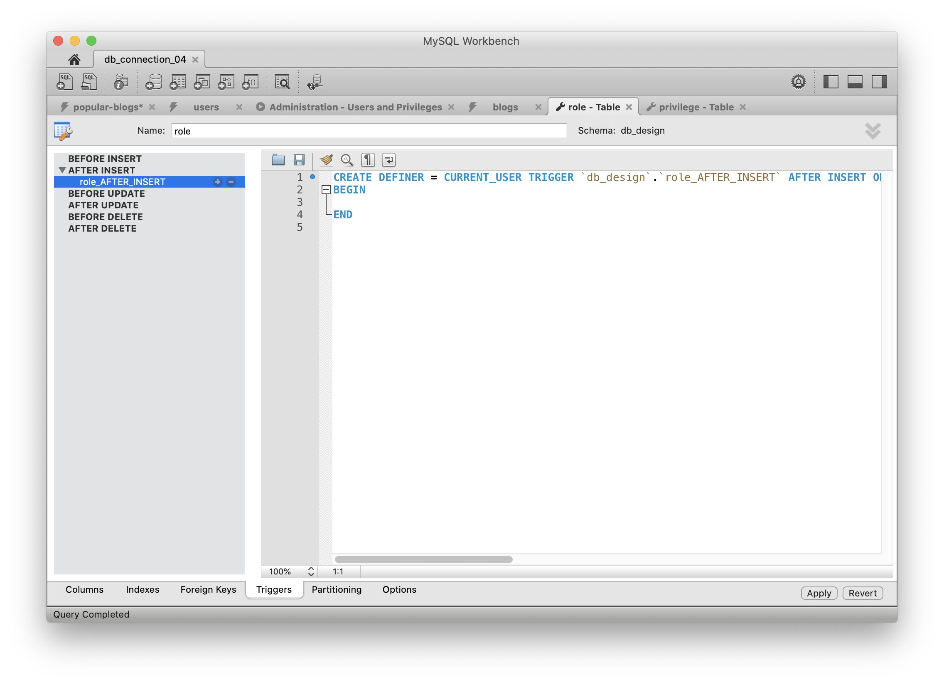
Create a New Trigger on Table
CREATE DEFINER = CURRENT_USER TRIGGER `db_design`.`role_AFTER_INSERT`
AFTER INSERT ON `roles` FOR EACH ROW
BEGIN
END

Slide 61
Insert Privileges if Insert Role
IF NEW.role = 'admin' THEN
INSERT INTO privileges VALUES (null, 'create', NEW.user_id);
INSERT INTO privileges VALUES (null, 'read', NEW.user_id);
INSERT INTO privileges VALUES (null, 'update', NEW.user_id);
INSERT INTO privileges VALUES (null, 'delete', NEW.user_id);
END IF;

Slide 62
Insert Privileges if Insert Role
IF NEW.role = 'editor' THEN
INSERT INTO privileges VALUES (null, 'read', NEW.user_id);
INSERT INTO privileges VALUES (null, 'update', NEW.user_id);
END IF;
IF NEW.role = 'reviewer' THEN
INSERT INTO privileges VALUES (null, 'read', NEW.user_id);
END IF;

Slide 63
Insert Admin Role to Trigger
INSERT INTO `db_design`.`roles` (`role`, `user_id`)
VALUES ('admin', '2');
SELECT * FROM db_design.privileges;
id | privilege | user_id
1 | create | 2
2 | read | 2
3 | update | 2
4 | delete | 2

Slide 64
Insert Editor Role to Trigger
INSERT INTO `db_design`.`roles` (`role`, `user_id`)
VALUES ('editor', '3');
SELECT * FROM db_design.privileges;
id | privilege | user_id
5 | read | 3
6 | update | 3

Slide 65
Insert Reviewer Role to Trigger
INSERT INTO `db_design`.`roles` (`role`, `user_id`)
VALUES ('editor', '4');
SELECT * FROM db_design.privileges;
id | privilege | user_id
7 | read | 4

Slide 66
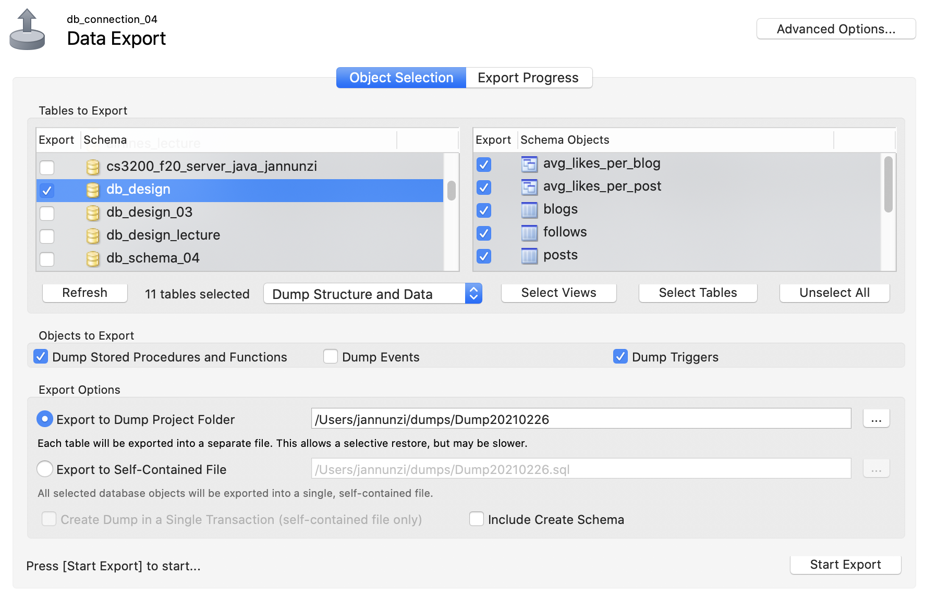
Export Triggers

